Slide 1
Serious Games and AI
Intro to Reinforcement Learning
Summer 2021
Notes:
1
1
Check distro statement before using:
DISTRIBUTION STATEMENT A. Approved for pubic release: distribution is unlimited.
This material is based upon work supported under Air Force Contract No. FA8721-05-C-0002 and/or FA8702-15-D-0001. Any opinions, findings, conclusions or recommendations expressed in this material are those of the author(s) and do not necessarily reflect the views of the U.S. Air Force.
© 2021 Massachusetts Institute of Technology.
Delivered to the U.S. Government with Unlimited Rights, as defined in DFARS Part 252.227-7013 or 7014 (Feb 2014). Notwithstanding any copyright notice, U.S. Government rights in this work are defined by DFARS 252.227-7013 or DFARS 252.227-7014 as detailed above. Use of this work other than as specifically authorized by the U.S. Government may violate any copyrights that exist in this work.

Slide 2
Overview
Basic Tenants
Basic Algorithms
Epsilon Greedy (Bandits)
Policy Evaluation
Policy Iteration
Q-Learning
Double Q-Learning
SARSA

Slide 3
RL Groundwork
Optimization
Find the best way to make decisions given constraints and restraints
Utility and rewards
Delayed consequences
Forecasting future rewards
Temporal credit assignment is very hard
Exploration / Exploitation
Local optima
Generalization
Why not use rule based policies?
Managing complexity
Notes:
https://web.stanford.edu/class/cs234/slides/lecture1.pdf

Slide 4
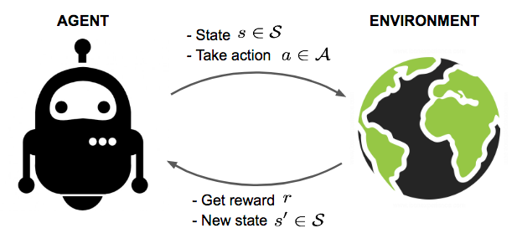
Basic Intuition
Explore the environment through interactions
Evaluate the utility of those interactions
Use the experience to guide future interactions
How do we actually do this though?
Notes:
https://web.stanford.edu/class/cs234/slides/lecture1.pdf
https://lilianweng.github.io/lil-log/2018/02/19/a-long-peek-into-reinforcement-learning.html

Slide 5
AI Tutor Example
Goal: teach the student addition and subtraction
AI Tutor suggests problems of the right difficulty to accelerate learning
AI Tutor gets rewarded +1 if the student gets the problem right
AI Tutor gets rewarded -1 if the students misses the problem
Modeling for RL:
State space:
Action space:
Reward function:
How would you behave as the AI Tutor
Note, you are not given any notion of problem difficulty to start with!
Notes:
https://web.stanford.edu/class/cs234/slides/lecture1.pdf

Slide 6
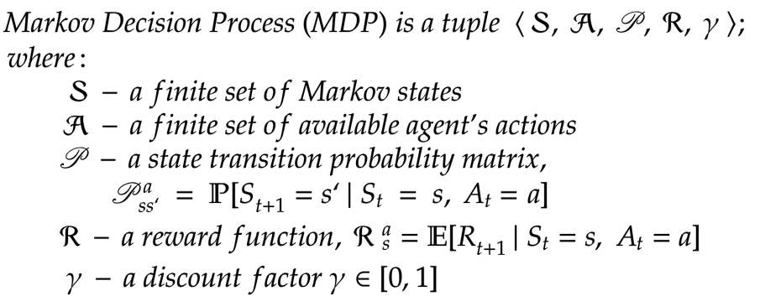
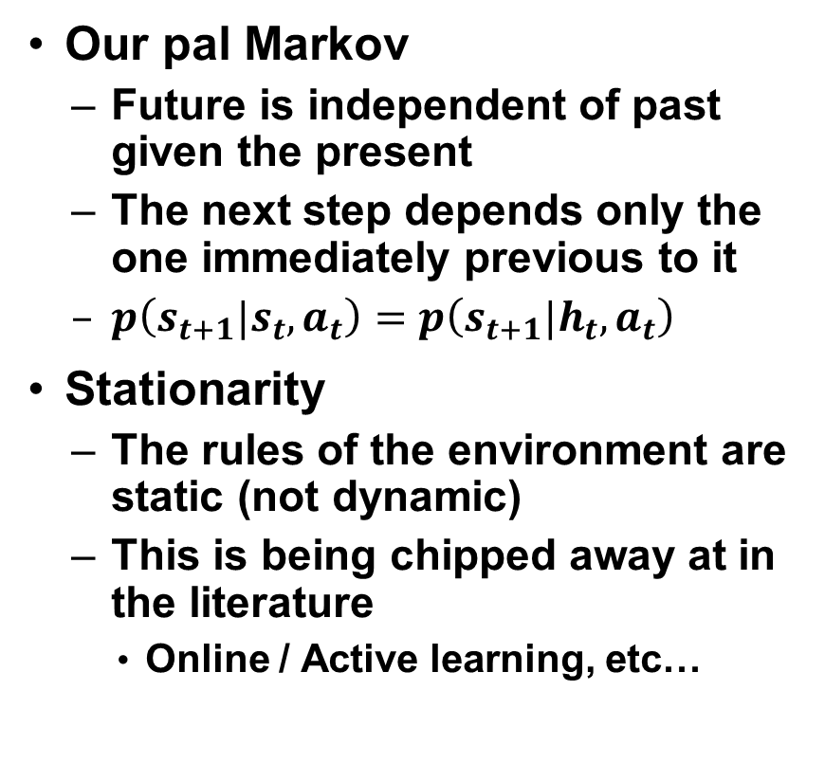
RL Assumptions
Our pal Markov
Future is independent of past given the present
The next step depends only the one immediately previous to it
$p\left(s_{t+1}|s_{t}, a_{t}\right)=p\left(s_{t+1}|h_{t}, a_{t}\right)$
Stationarity
The rules of the environment are static (not dynamic)
This is being chipped away at in the literature
Online / Active learning, etc…
Notes:
https://web.stanford.edu/class/cs234/slides/lecture1.pdf
https://programmingbee.net/2019/01/01/rl-part-3-markov-decision-process-policy-bellman-optimality-equation/

Slide 7
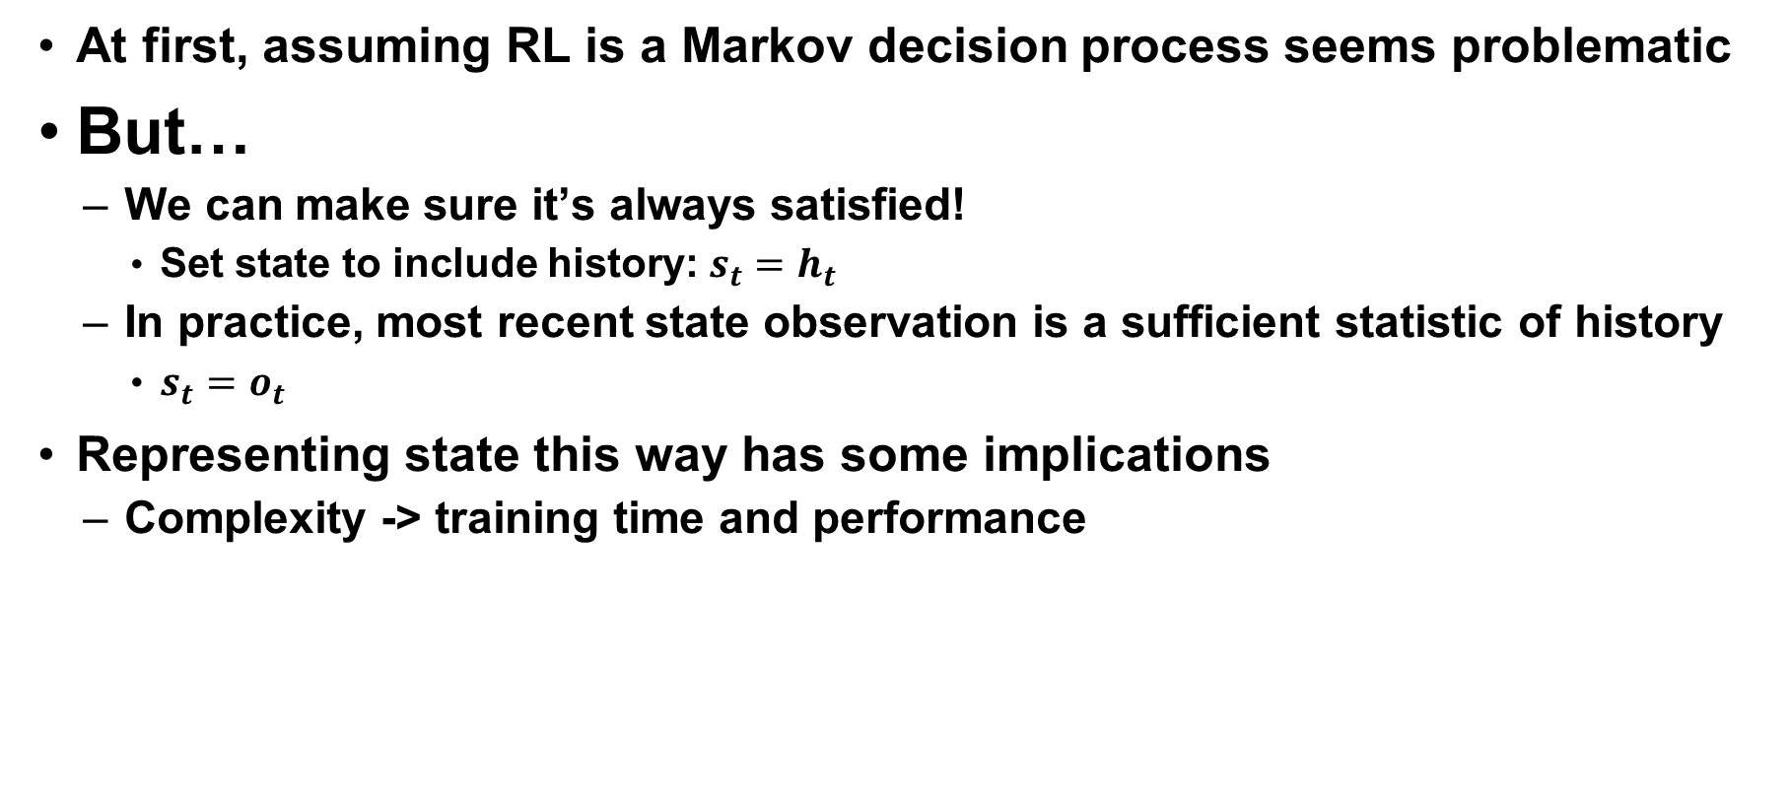
Why are we ok with Markov?
At first, assuming RL is a Markov decision process seems problematic
But…
We can make sure it’s always satisfied!
Set state to include history: $s_{t}=h_{t}$
In practice, most recent state observation is a sufficient statistic of history
$s_{t}=o_{t}$
Representing state this way has some implications
Complexity -> training time and performance
Notes:
https://web.stanford.edu/class/cs234/slides/lecture1.pdf

Slide 8
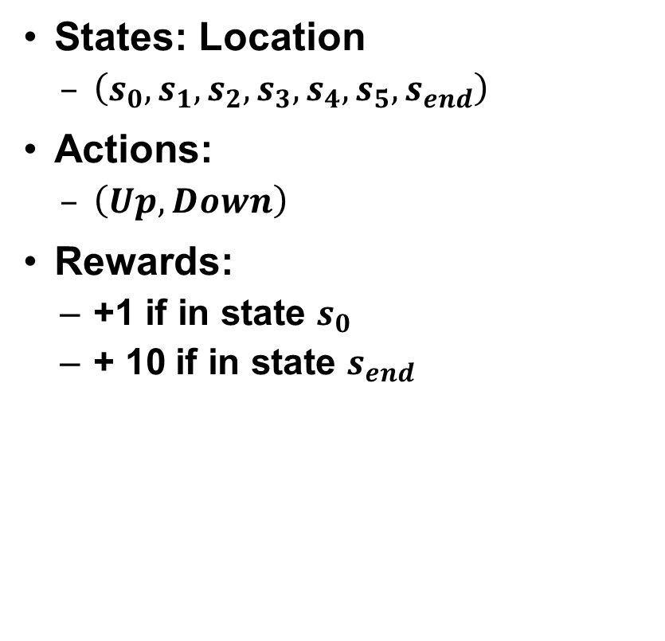
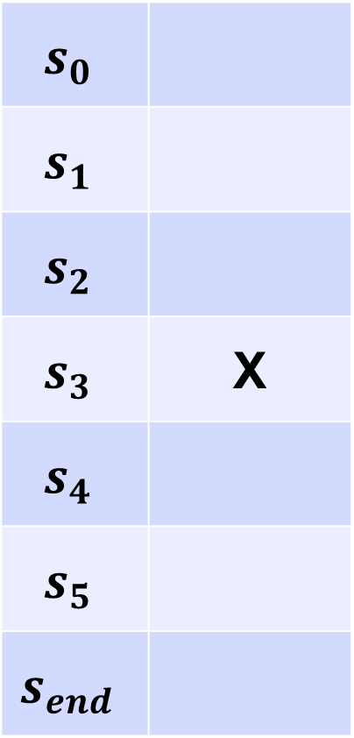
Toy Example
$$s_{0}$$
$$s_{1}$$
$$s_{2}$$
$$s_{3}$$ | X
$$s_{4}$$
$$s_{5}$$
$$s_{end}$$
States: Location
$\left(s_{0}, s_{1}, s_{2}, s_{3}, s_{4}, s_{5}, s_{end}\right)$
Actions:
$\left(Up, Down\right)$
Rewards:
+1 if in state $s_{0}$
+ 10 if in state $s_{end}$
Adapted from: Stanford CS234 Course Examples
Notes:
https://web.stanford.edu/class/cs234/slides/lecture1.pdf

Slide 9

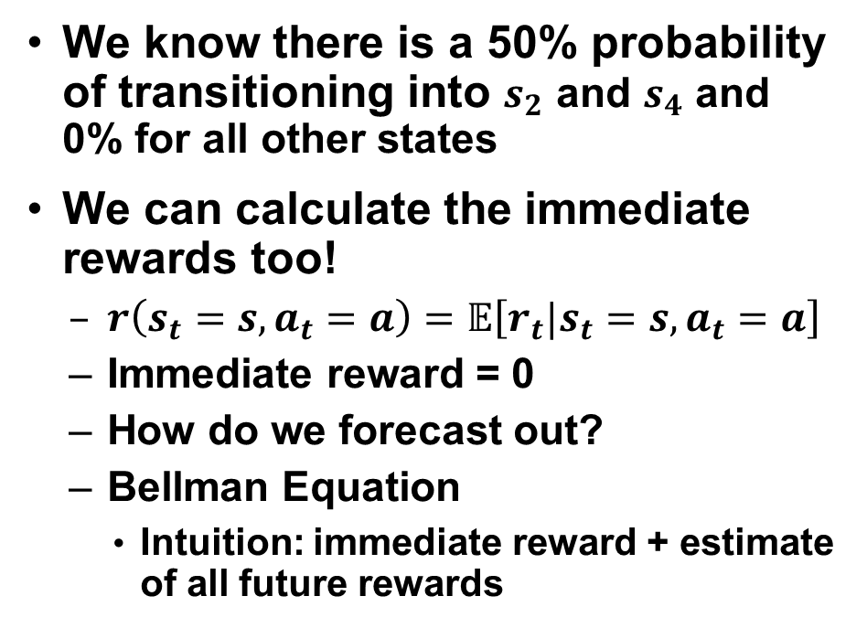
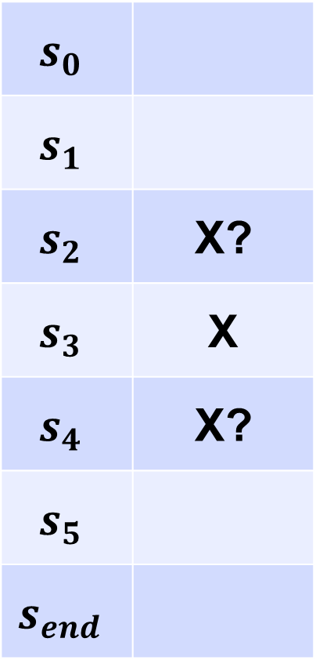
Toy Example
$$s_{0}$$
$$s_{1}$$
$$s_{2}$$ | X?
$$s_{3}$$ | X
$$s_{4}$$ | X?
$$s_{5}$$
$$s_{end}$$
We know there is a 50% probability of transitioning into $s_{2}$ and $s_{4}$ and 0% for all other states
We can calculate the immediate rewards too!
$r\left(s_{t}=s, a_{t}=a\right)=𝔼\left[r_{t}|s_{t}=s, a_{t}=a\right]$
Immediate reward = 0
How do we forecast out?
Bellman Equation
Intuition: immediate reward + estimate of all future rewards
Notes:
https://web.stanford.edu/class/cs234/slides/lecture1.pdf

Slide 10
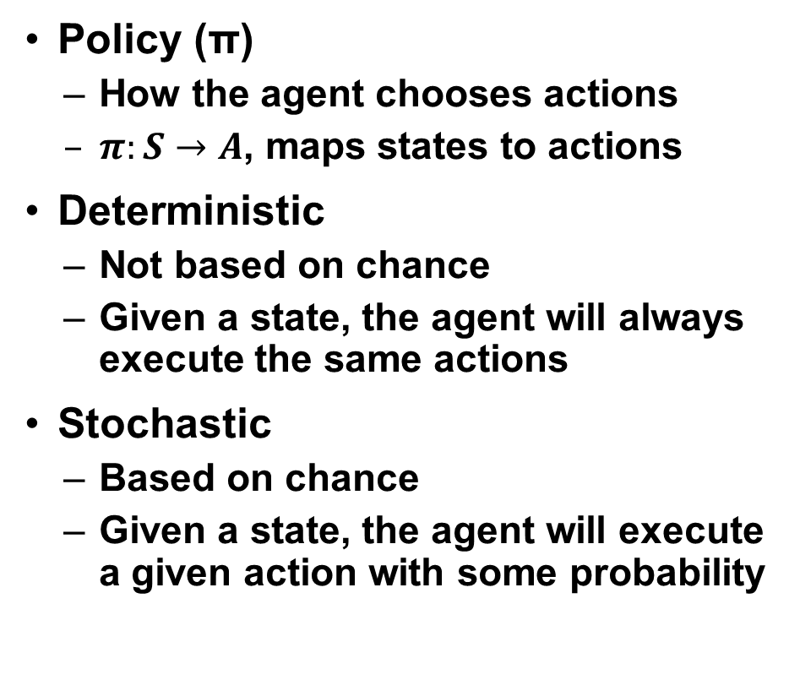
Toy Example
$$s_{0}$$
$$s_{1}$$
$$s_{2}$$
$$s_{3}$$ | X
$$s_{4}$$
$$s_{5}$$
$$s_{end}$$
Policy (π)
How the agent chooses actions
$π:S→A$, maps states to actions
Deterministic
Not based on chance
Given a state, the agent will always execute the same actions
Stochastic
Based on chance
Given a state, the agent will execute a given action with some probability
Notes:
https://web.stanford.edu/class/cs234/slides/lecture1.pdf

Slide 11
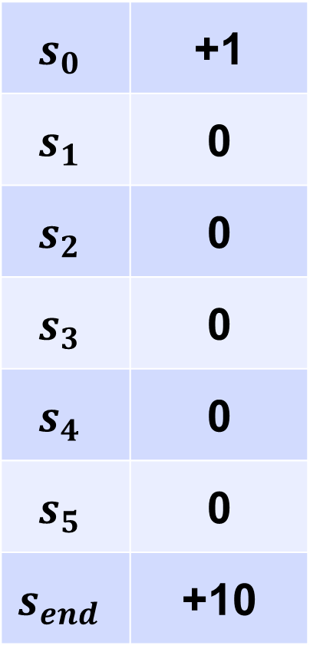
Toy Example
$$s_{0}$$ | +1
$$s_{1}$$ | 0
$$s_{2}$$ | 0
$$s_{3}$$ | 0
$$s_{4}$$ | 0
$$s_{5}$$ | 0
$$s_{end}$$ | +10
What if?
The agent uses a deterministic policy of “Up”?
Deterministic “Down”?
Stochastic policy of 75% “Up” and 25% “Down”?
Stochastic 50% / 50%?
How are you forecasting future rewards?
Value Function
What is a discount factor?
Notes:
https://web.stanford.edu/class/cs234/slides/lecture1.pdf

Slide 12
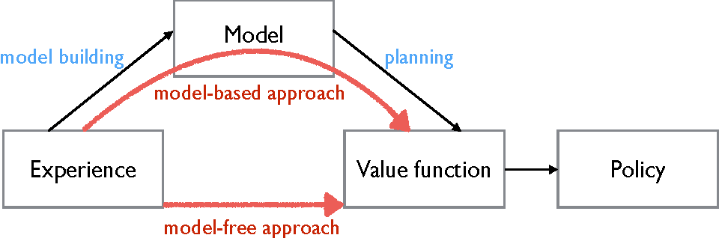
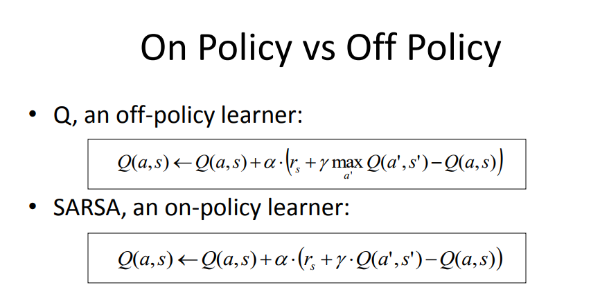
Types of RL Agents
Model-Based
Model, optional policy and/or value function
Model-Free
No model, has a policy / value function
On-Policy
Policy is influenced by the exploration policy (policy = behavioral)
More susceptible to local optima
Off-Policy
Policy is independent of exploration policy (policy != behavioral)
Less susceptible to local optima
Notes:
https://web.stanford.edu/class/cs234/slides/lecture1.pdf
https://www.semanticscholar.org/paper/Strengths%2C-Weaknesses%2C-and-Combinations-of-and-Asadi/5f936eae11c88150c1874fc0615f95aa435a9567
https://datascience.stackexchange.com/questions/26471/is-my-understanding-of-on-policy-and-off-policy-td-algorithms-correct

Slide 13
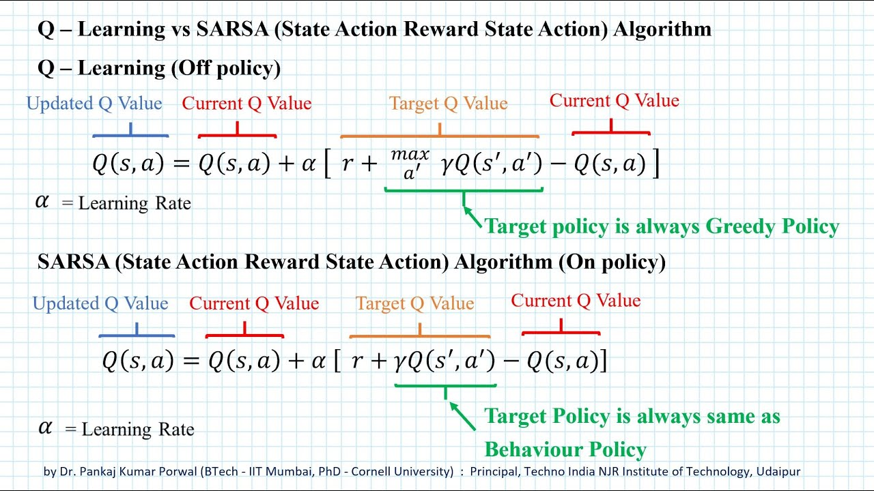
Types of RL Agents
https://www.youtube.com/watch?v=FhSaHuC0u2M
Notes:
https://web.stanford.edu/class/cs234/slides/lecture1.pdf
https://images.app.goo.gl/FeDdHN4MqkThQDQe8

Slide 14
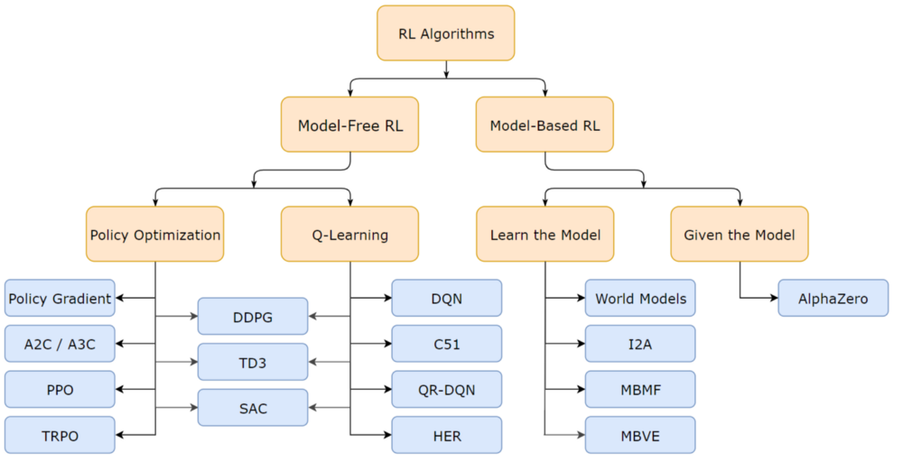
RL Algorithms
Notes:
https://web.stanford.edu/class/cs234/slides/lecture1.pdf
https://medium.com/@SmartLabAI/reinforcement-learning-algorithms-an-intuitive-overview-904e2dff5bbc

Slide 15
Basic Algorithms
Epsilon Greedy (Multi-Armed Bandits)
Upper Confidence Bound (UCB)
Policy Evaluation
Policy Iteration
Q-Learning
SARSA
This is an introduction for exposure, NOT a comprehensive list!

Slide 16
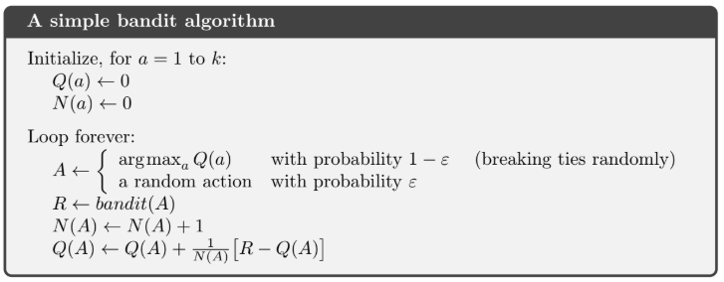
Epsilon Greedy (Bandits)

Slide 17
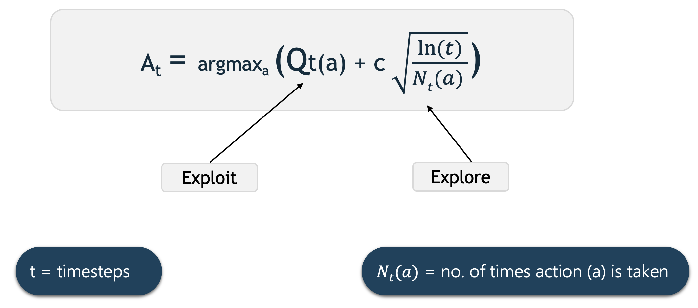
Upper Confidence Bound (UCB)
Notes:
https://www.geeksforgeeks.org/upper-confidence-bound-algorithm-in-reinforcement-learning/

Slide 18
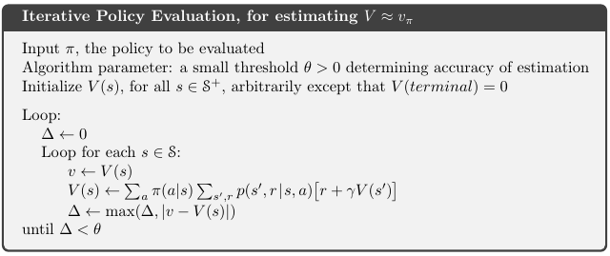
Policy Evaluation
Notes:
https://www.geeksforgeeks.org/upper-confidence-bound-algorithm-in-reinforcement-learning/

Slide 19
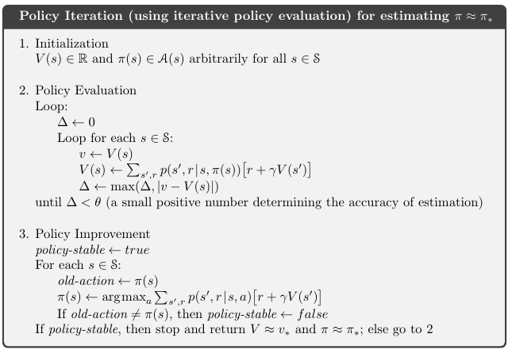
Policy Iteration
Notes:
https://www.geeksforgeeks.org/upper-confidence-bound-algorithm-in-reinforcement-learning/

Slide 20
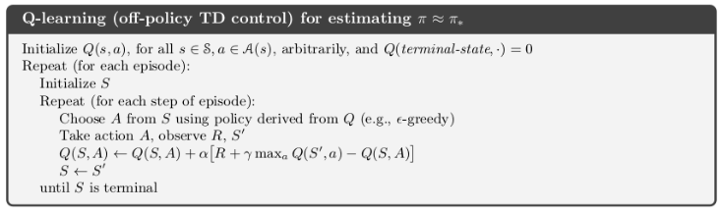
Q-Learning
Notes:
https://www.geeksforgeeks.org/upper-confidence-bound-algorithm-in-reinforcement-learning/

Slide 21
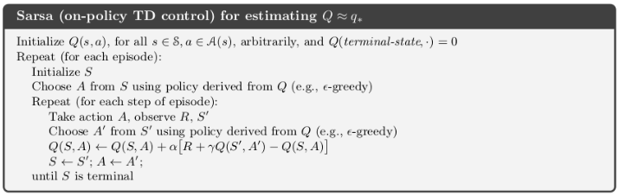
State-Action-Reward-State-Action (SARSA)
Notes:
https://www.geeksforgeeks.org/upper-confidence-bound-algorithm-in-reinforcement-learning/

Slide 22




